Slide 1


Gujarat Technological University
NEW L. J. INSTITUTE OF ENGINEERING AND TECHNOLOGY
DEPARTMENT OF IT
ACADEMIC YEAR – 2025
Internship (3184201)
University ChatBot
PREPARED BY,
GOPESHKUMAR HARSUKH RABADIYA
ENROLLMENT NUMBER:211430116017
HOD NAME: Dr Gayatri Pandi
IT,
NEW LJIET.
GUIDED BY,
Ms. Priya Chaturvedi
SEMESTER: 8th DEPARTMENT OF INFORMATION TECHNOLOGY

Slide 2
Outline
ABSTRACT
PROBLEMS IN EXISTING SYSTEM
PURPOSE OF THE PROJECT
FUNCTION REQUIREMENTS
SYSTEM MODULES
SYSTEM REQUIREMENTS
FRONT END AND BACK END OF SYSTEM
DATA DICTIONARY
SNAPSHOT OF WEBSITE
FUTURE ENHANCEMENT

Slide 3
ABSTRACT
University Chatbot is an AI-powered assistant built using Google Gemini Pro, Streamlit, and Python. It provides instant responses to university-related queries such as courses, admissions, deadlines, and more. Integrated with MongoDB and SQLite for data storage, the system aims to improve communication and support between students and institutions through natural language interaction.

Slide 4
2. PROBLEMS IN EXISTING SYSTEM
Students often face delays in receiving academic information.
Manual query resolution requires staff time and effort.
No centralized digital assistant is available for quick support.
Limited access to support outside working hours.

Slide 5
3. PURPOSE OF THE PROJECT
To develop a chatbot that simulates a university helpdesk.
To reduce workload on administrative staff.
To provide 24/7 support using natural language processing.
To deliver smart, session-based responses using Gemini API.

Slide 6
4. FUNCTION REQUIREMENTS
User login/signup functionality.
Real-time chatbot interaction.
Session management and chat history.
Integration with Gemini Pro for responses.
Data storage in MongoDB and SQLite.

Slide 7
5. SYSTEM MODULES
Authentication Module: Login & Signup
Chat Interface: User input & bot reply
Session Handler: Maintains conversation context
Database Layer: MongoDB (cloud) & SQLite (local)
Gemini Integration: For generating intelligent replies

Slide 8
6. SYSTEM REQUIREMENTS
Hardware:
Minimum 4GB RAM, i3 Processor or above
Software:
Python 3.x
Streamlit
MongoDB Atlas, SQLite
Web Browser (Chrome/Edge)
Cloud API:
Google Gemini Pro

Slide 9
7. FRONT END AND BACK END OF SYSTEM
Front End:
Developed in Streamlit
Clean UI with chat interface
Back End:
Python for logic handling
Gemini Pro for AI-based responses
MongoDB/SQLite for data management

Slide 10
8. DATA DICTIONARY
Field Name | Description | Type
username | Registered user name | String
email | User email ID | String
message | User's question | Text
reply | Chatbot's response | Text
timestamp | Chat time and date | DateTime
session_id | Unique session ID | String

Slide 11
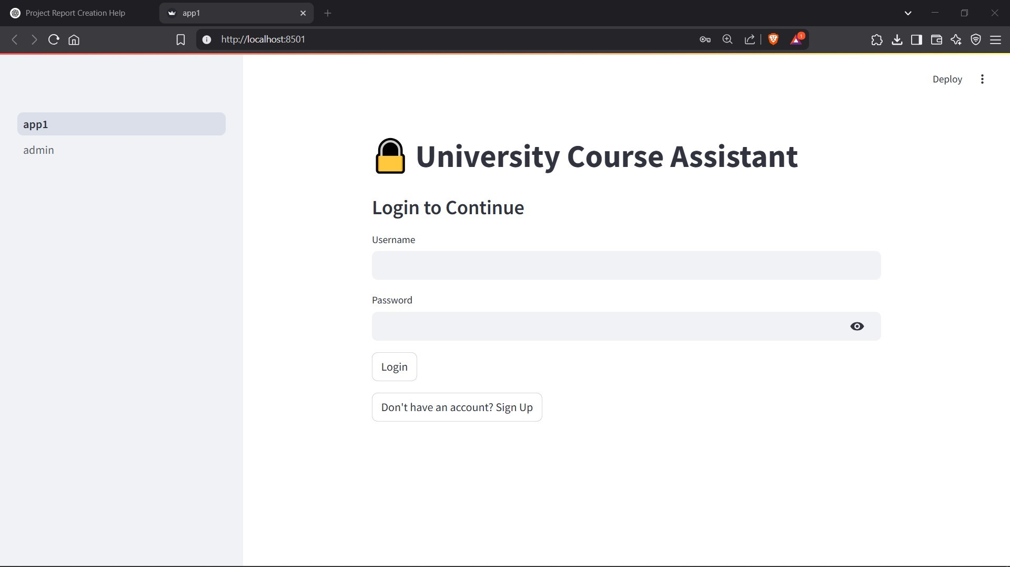
9. SNAPSHOT OF WEBSITE
Login/Sign Up page

Slide 12
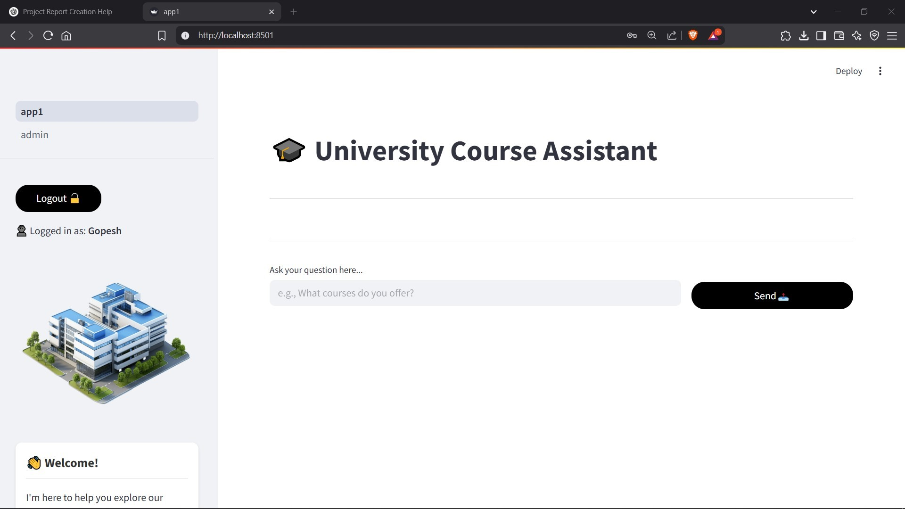
Home Page Of chatbot

Slide 13
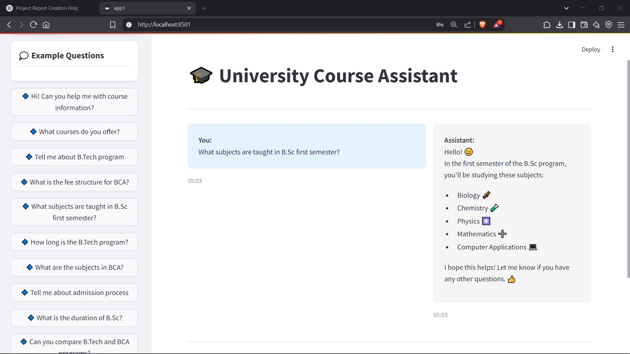
Example of a Question

Slide 14
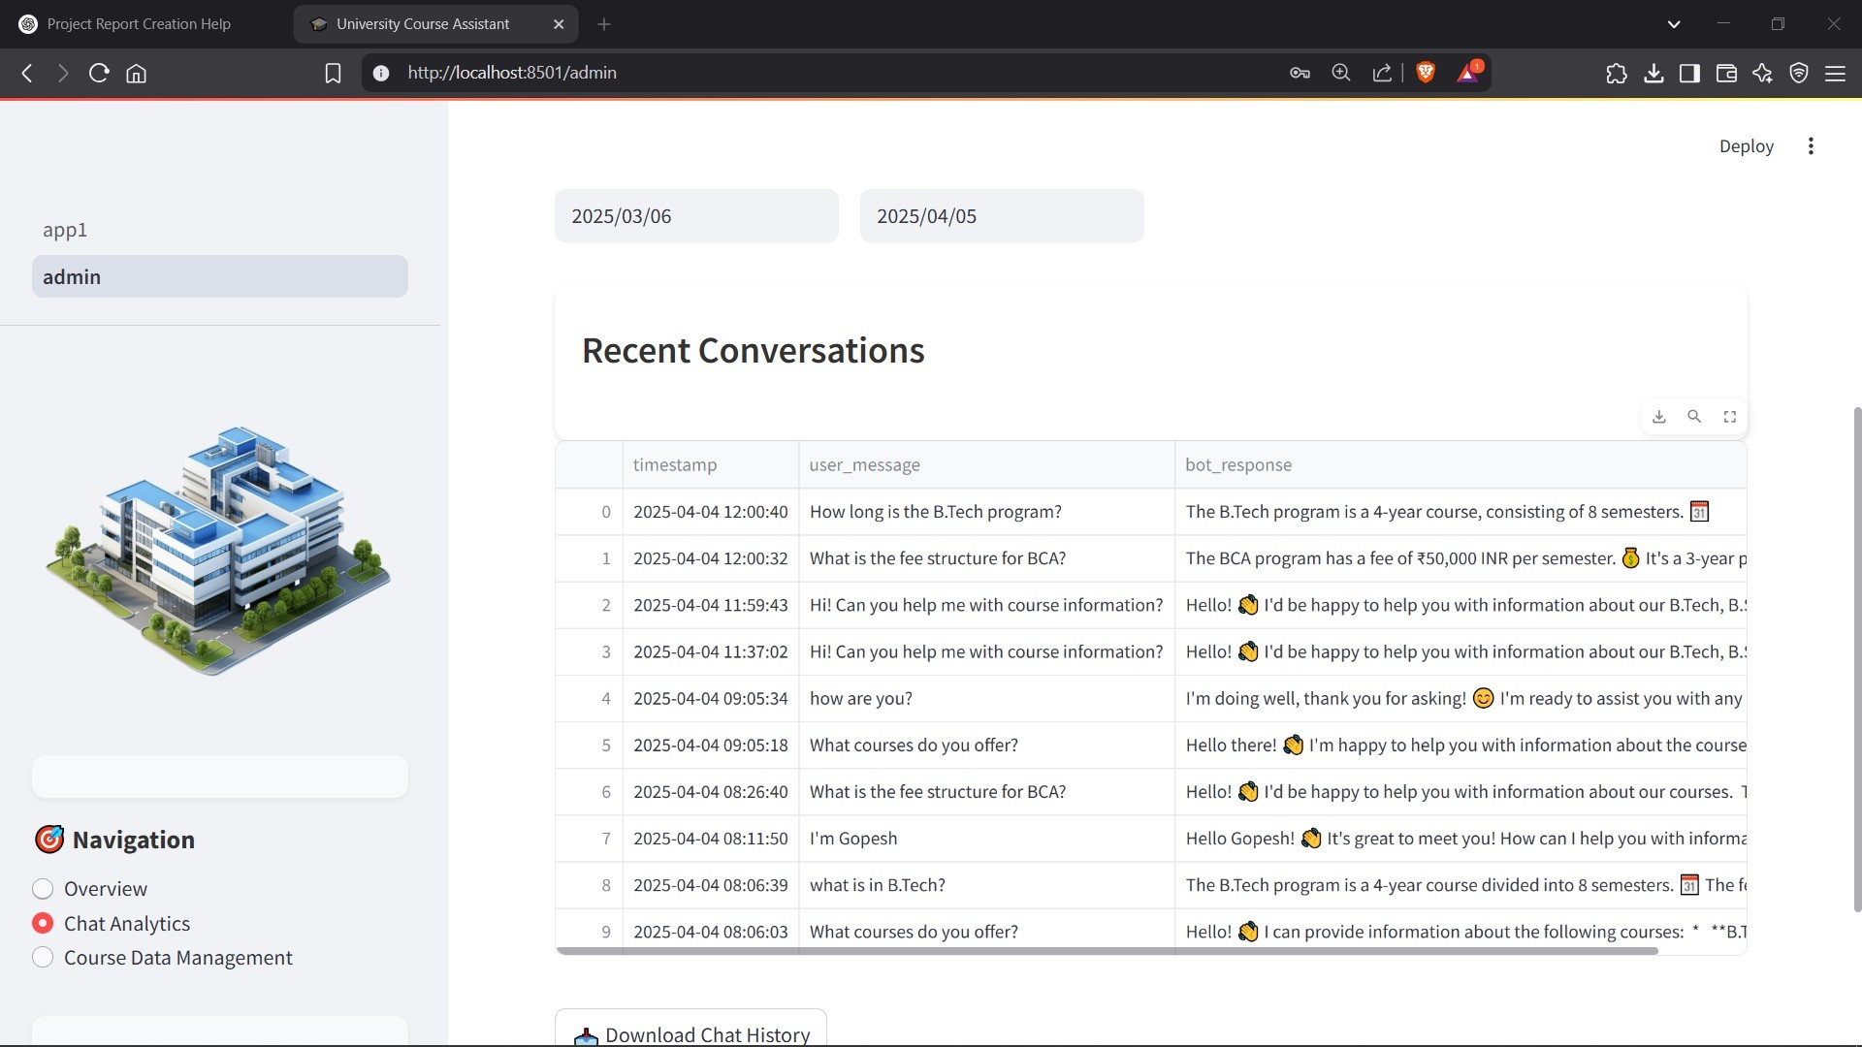
Admin Panel – Chat Analysis

Slide 15
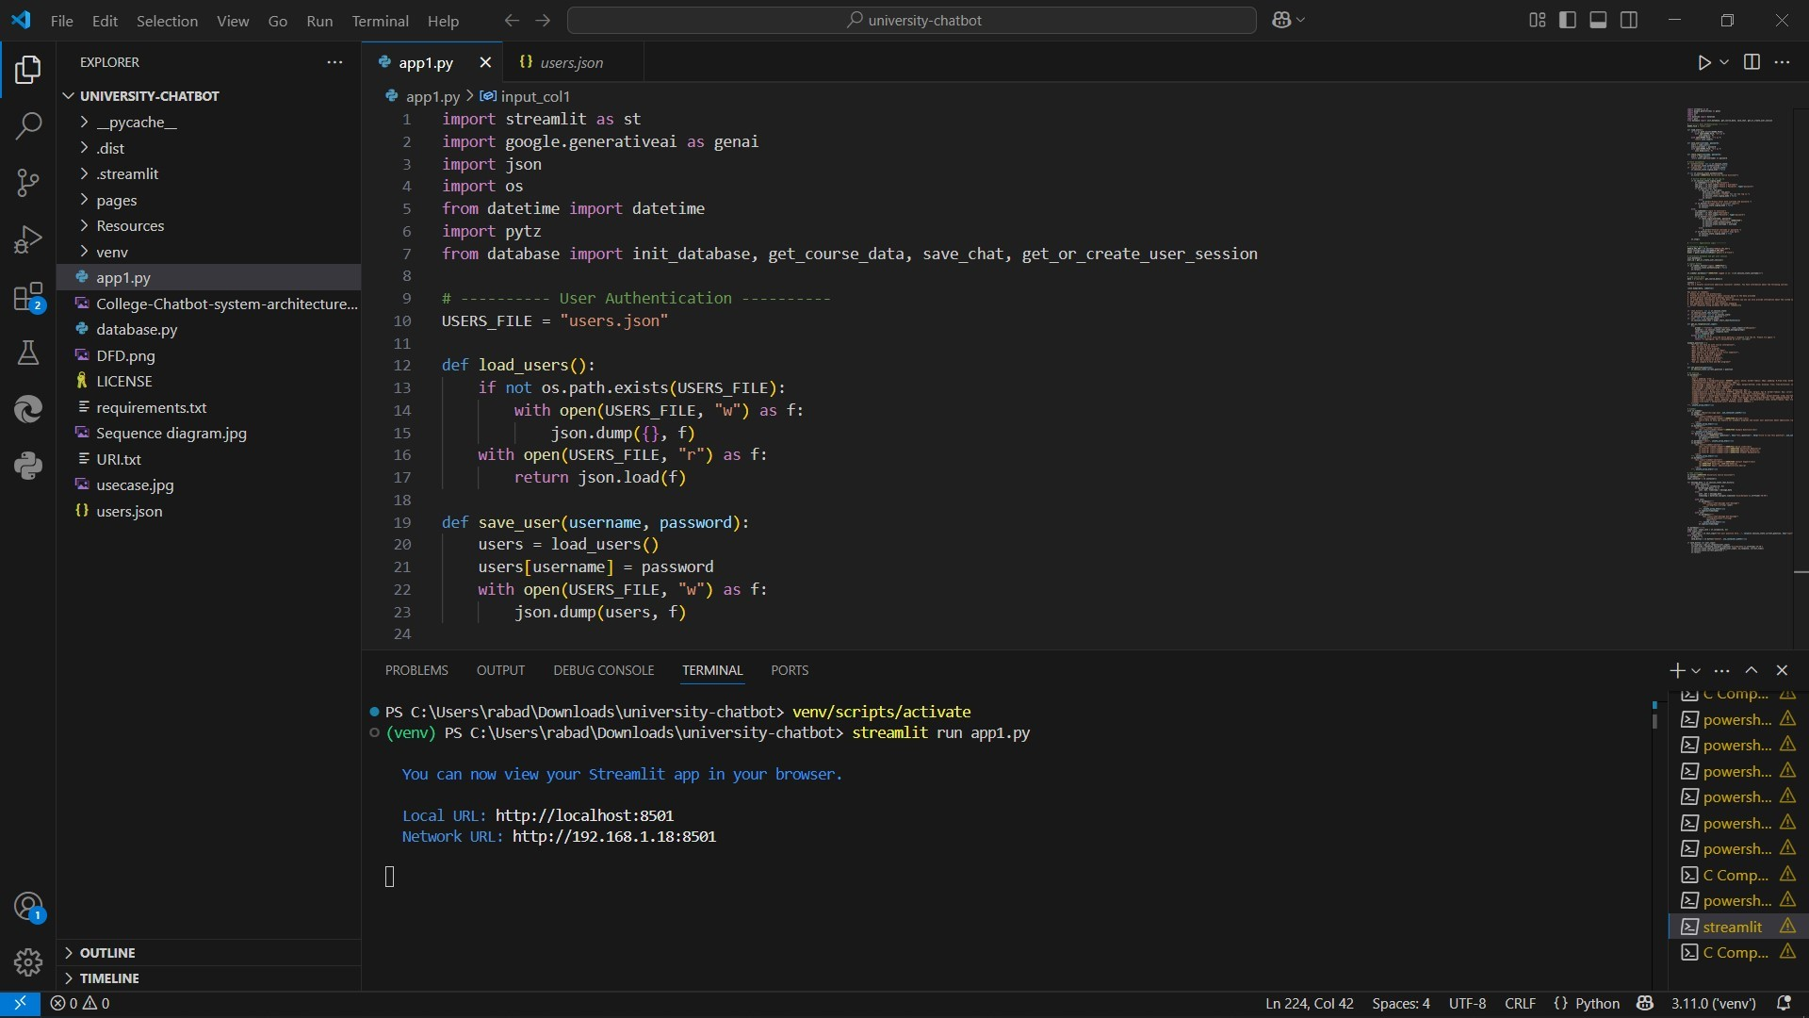
How To Run A Server

Slide 16
10. FUTURE ENHANCEMENT
Add voice-based chat capabilities
Introduce multilingual support
Create an admin analytics dashboard
Integrate with live university data (e.g., timetable, fees)
Deploy with advanced user authentication

Slide 17


